Slide 1
Spring SECURITY (RSA)
By Srinivas Basha

Slide 2
JWT (JSON Web Token)
Introduction
JSON Web Token (JWT) is an open standard (RFC 7519) that defines a compact and self-contained way for securely transmitting information between parties as a JSON object. This information can be verified and trusted because it is digitally signed. JWTs can be signed using a secret (with the HMAC algorithm) or a public/private key pair using RSA.
Plain JWT Implementation (HMAC)
Both signing and verification use the same secret key.
If an attacker gains access to the secret key, they can create and validate tokens.
An attacker with access to the key can forge the token.
JWT Asymmetric Encryption With RSA
The private key is for signing and the public key is for verification
if an attacker gains access to the public key, they cannot generate a valid signature because the signing requires the private key, which remains securely on the server.

Slide 3
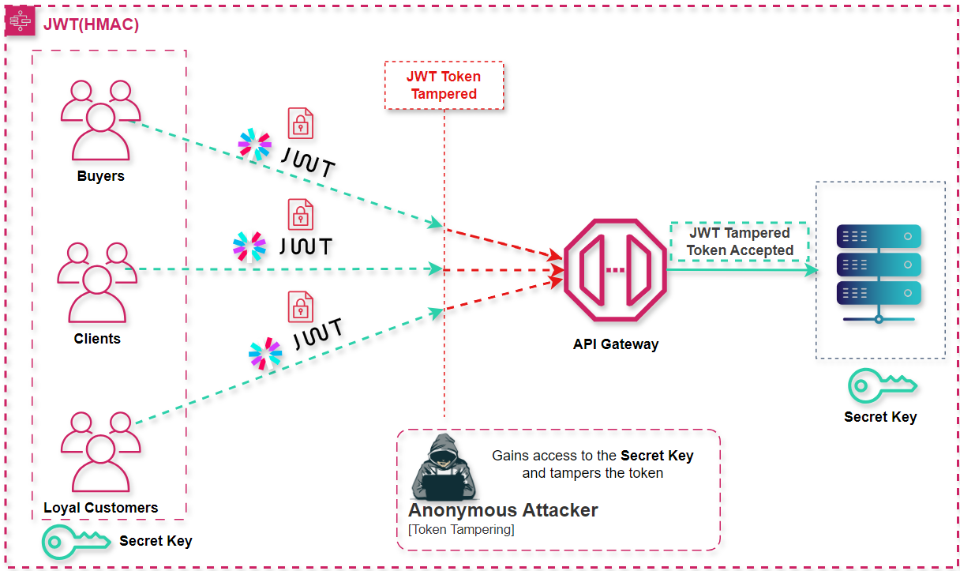
JWT with HMAC

Slide 4
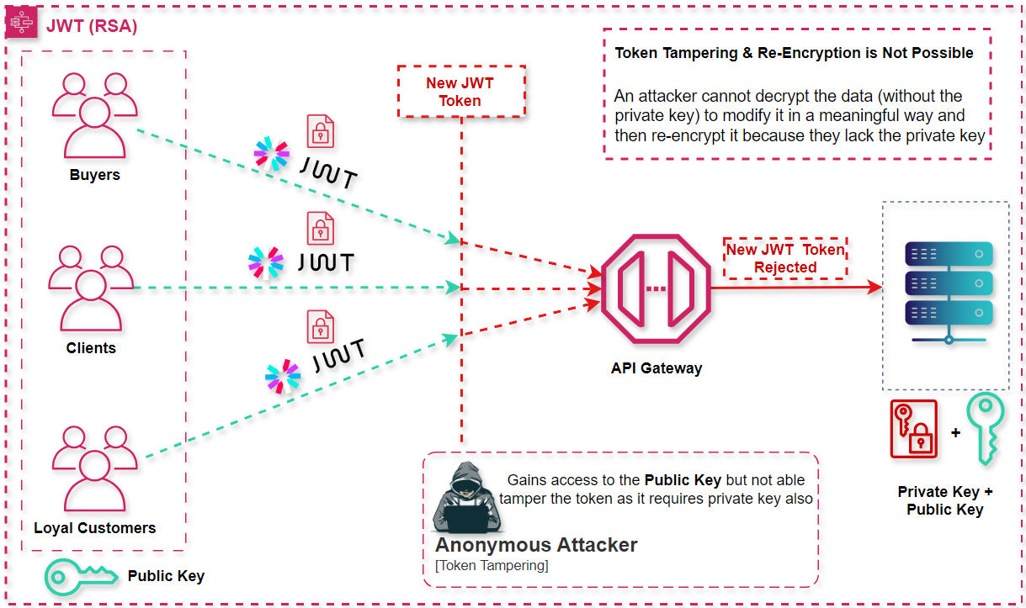
JWT with RSA

